Slide 1
Welcome to our Patrick Henry Families!
Family Orientation
August 2020

Slide 2
Agenda
Teacher Introduction
Review the Banker Box materials
Review the Virtual Learning Schedule for Quarter 1
Intro to the iPad
Intro to Teams

Slide 3
Teacher Introductions
PreK: Ms. Smith, Ms. Munnelly, Ms. Valentine, Ms. Patti
KG: Ms. Willard, Ms. Wildermuth
1st: Ms. Versen, Ms. Butler
2nd: Ms. Teska, Ms. Fales
3rd: Ms. Jackson, Ms. Ivory
4th/5th: Ms. Hammock, Ms. Williams
Special Education: Ms. Baumann, Ms. Griffin
Related Arts: Ms. Terrance, Ms. Bryant, Ms. Blake

Slide 4
Banker Box Materials
Teacher Intro Letter
Enrollment Documents – Code of Conduct, Family Contact Information
Virtual Schedule
iPad and Charger

Slide 5
Virtual Learning Schedule
School day runs 8:15am – 3:12pm
8:00-8:15, Log into Teams
8:15-11:00, Virtual Instruction
11:00-11:30, Lunch Break
11:30-3:12, Virtual Instruction + Related Arts
3:12-3:22, Teacher Office Hours on Teams

Slide 6
Intro to the ipad

Slide 7
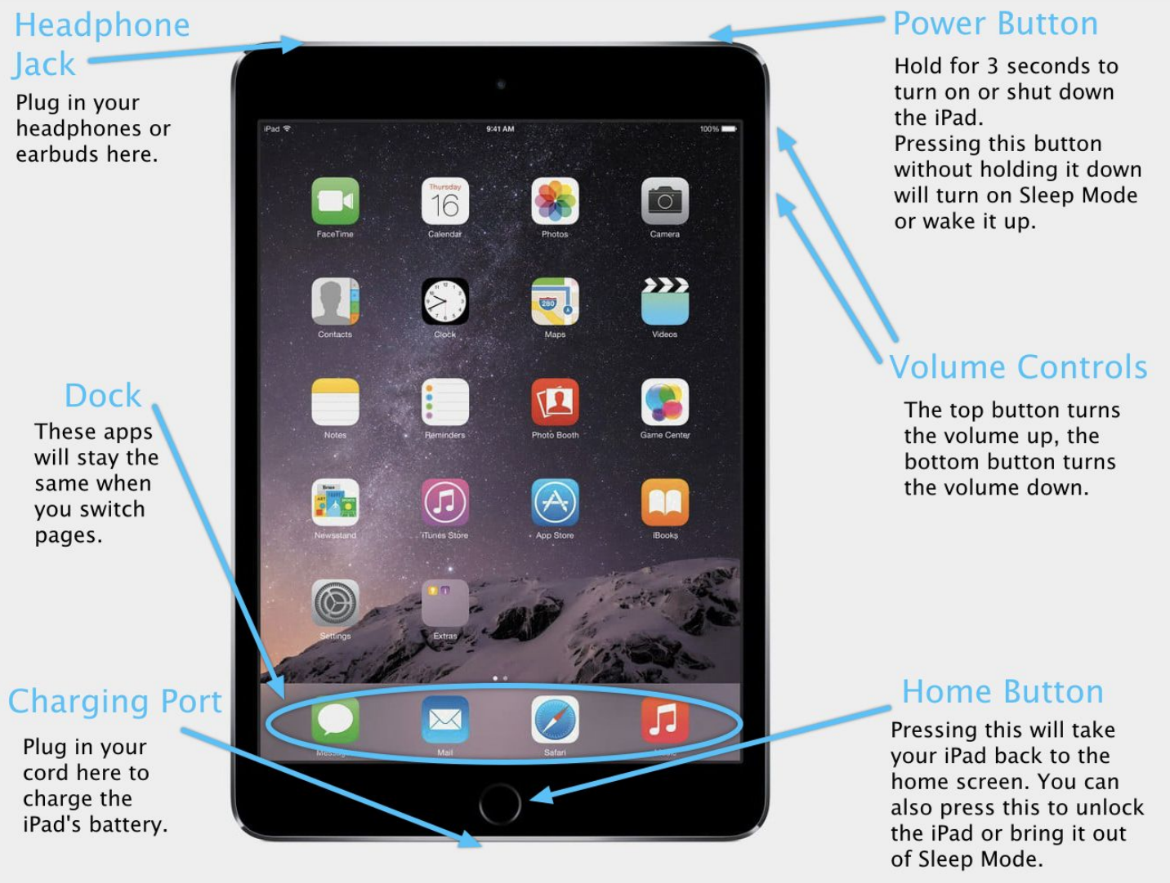

Slide 10
Intro to the ipad
For your reference: https://www.macworld.co.uk/how-to/ipad/how-use-ipad-3671323/
How do I turn it on? Power button – top right
How do I turn it off? Power button – top right
How do I change the volume? Volume controls – side right
How do I charge it? Charging station – bottom center

Slide 11
Intro to the ipad
How do I get to the Home screen? Home button – bottom center circular button
How do I open an app? Single tap the app once
How do I exit an app? Press the home button

Slide 12
Intro to Microsoft Teams
What is Teams?
A virtual platform used for teaching and learning, live instruction from your teacher, and storing assignments
What will we use it for this quarter?
Live lessons, videos, asynchronous work time, tracking assignments, and teacher communication
How do I log on?
Username@slps.org (your login information is in your box)
Example: drogers3800@slps.org

Slide 13
Let’s try and log in
How do I log on?
Username@slps.org (your login information is in your box)
Example: drogers3800@slps.org

Slide 14
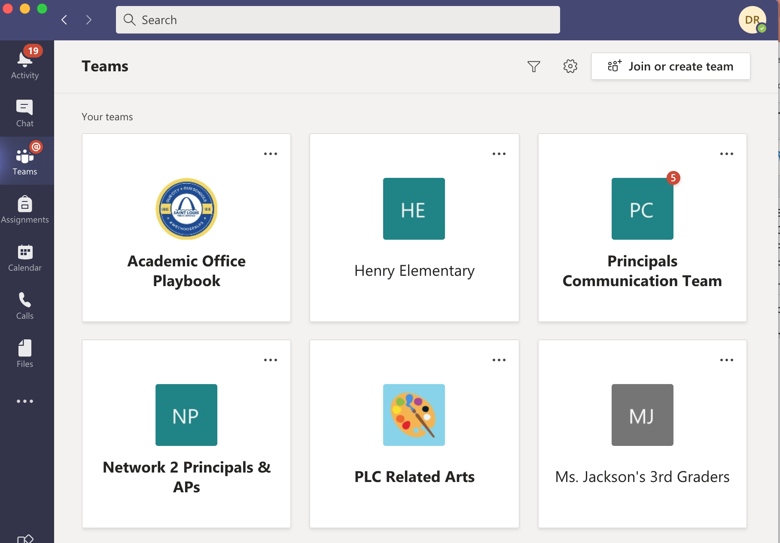

Slide 15
Intro to Microsoft Teams
Go to the Teams tab
Some of your teachers have already added you to their Team
There is a homescreen that will show you every post the teacher has made
There are tabs at the top that say “Posts” and “Files”
“Posts” is everything the teacher has posted in a running list
“Files” holds all of the files for the general class

Slide 16
Intro to Microsoft Teams
On the left, you’ll also see tabs
The first is just the teacher’s name – this will take you back to the homescreen if you get lost at any point
“General” is anything the teacher posts to the class that deals with all subject areas or any announcements she wants to make
“Hidden Channels” – this is where your teacher can break down the content by subject area and have a separate page for Math, Science, etc.

Slide 17
Intro to Microsoft Teams
What do the tabs do at the bottom/side of Teams?
“Activity”: receive notifications from any of your teams
“Chat”: works like texting or old school AOL Instant Message
“Teams:” takes you to a home screen for all of your teams
“Assignment”: shows you all of your current/past assignments
“Calendar”: gives an overview of anything any of your Teams has posted as a due date
“Files”: takes you to an overview of any files that have been shared with you

Slide 18
Intro to Microsoft Teams
How to join a Teams online class call:
You'll receive an email invitation to an online class meeting from your instructor or school administrator. To accept it, just click the green check-mark in the invitation.
There are several ways you can join your online class when it starts.
If you have Teams open, once your instructor begins the meeting, you'll see a pop-up notification at the bottom right corner of your screen announcing the start of the meeting. Select Join to join the meeting.
You can also go to your Teams calendar. All of your online meetings are listed there. To join a meeting, double-click the meeting, and then select Join in the upper right corner.
Right-click the meeting in your calendar and select Join online.

Slide 19
Intro to Microsoft Teams
Introduction Video: https://support.microsoft.com/en-us/office/creating-attending-and-running-meetings-while-using-teams-for-distance-learning-788d730f-2c7e-4761-a059-c9b3fe87adf7#ID0EACAAA=For_students

